Slide 1

Algebra 1
Unit 2, Lesson 5 Adding and Subtracting Polynomials Volume 1, pg. 79

Slide 2


Benchmark
MA.912.AR.1.3
Add, subtract and multiply polynomial expressions with rational number coefficients.
volume 1, pg. 79

Slide 3
Integrated Mathematical Thinking and Reasoning Standards
MA.K12.MTR.1.1 Actively participate in effortful learning both individually and collectively.
MA.K12.MTR.2.1 Demonstrate understanding by representing problems in multiple ways.
MA.K12.MTR.4.1 Engage in discussions that reflect on the mathematical thinking of self and others.
MA.K12.MTR.5.1 Use patterns and structure to help understand and connect mathematical concepts.
volume 1, pg. 79

Slide 4

Learning Target
I can add and subtract polynomials.
volume 1, pg. 79

Slide 5

Warm-Up
volume 1, pg. 80

Slide 6
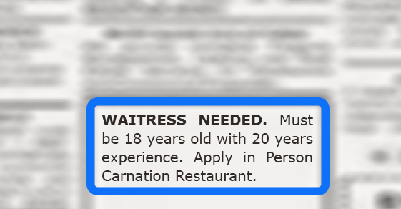
2.5.1 Warm-Up: Math Fail
The classified advertisement shown is an example of a math fail.
What do you notice about the advertisement that makes it a math fail?
volume 1, pg. 80
Notes:
Video Link: https://algebranation.wistia.com/medias/fi4fidi5y8

Slide 7

Guided Instruction
volume 1, pg. 80

Slide 8



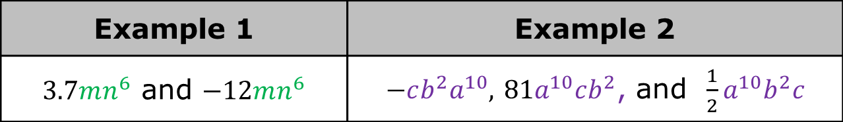
2.5.2 Guided Instruction: Adding Polynomials
Like terms are those whose variable(s) and their corresponding exponents are the same.
The following are examples of like terms.
Discuss with your partner why $5ev^{9}$ and $5ev^{3}$ are not like terms. Summarize your discussion.
Example 1 | Example 2
$3.7mn^{6}$ and $−12mn^{6}$ | $−cb^{2}a^{10},$ $81a^{10}cb^{2}$, and $\frac{1}{2}a^{10}b^{2}c$
volume 1, pg. 80

Slide 9
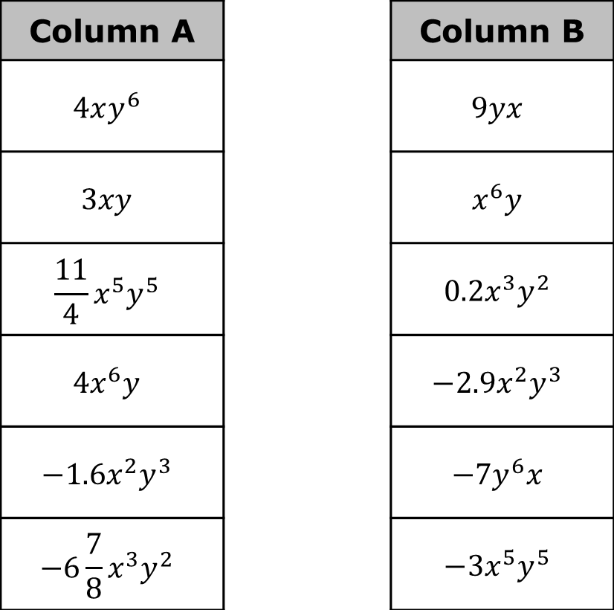
Draw an arrow to match the like terms between column A to column B. Then, check your matches with your partner.
Column A |  | Column B
$$4xy^{6}$$ |  | $$9yx$$
$$3xy$$ |  | $$x^{6}y$$
$$\frac{11}{4}x^{5}y^{5}$$ |  | $$0.2x^{3}y^{2}$$
$$4x^{6}y$$ |  | $${−2.9x}^{2}y^{3}$$
$$−1.6x^{2}y^{3}$$ |  | $$−7y^{6}x$$
$$−6\frac{7}{8}{x^{3}y}^{2}$$ |  | $$−3x^{5}y^{5}$$
volume 1, pg. 80

Slide 10
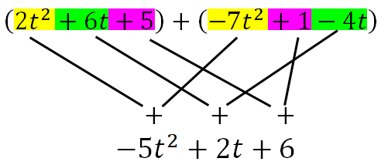
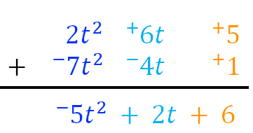
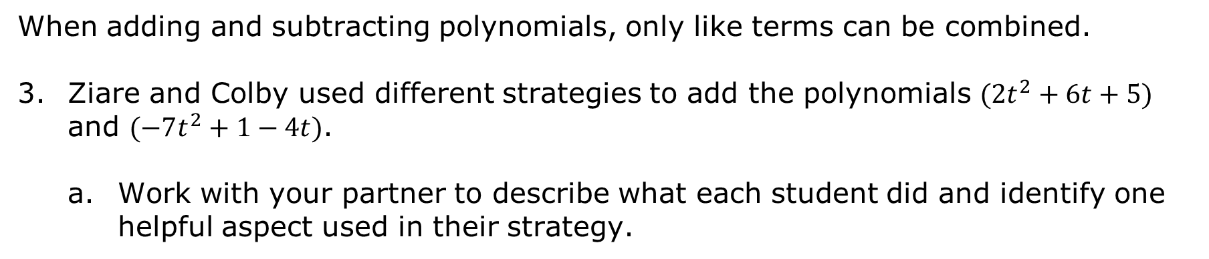
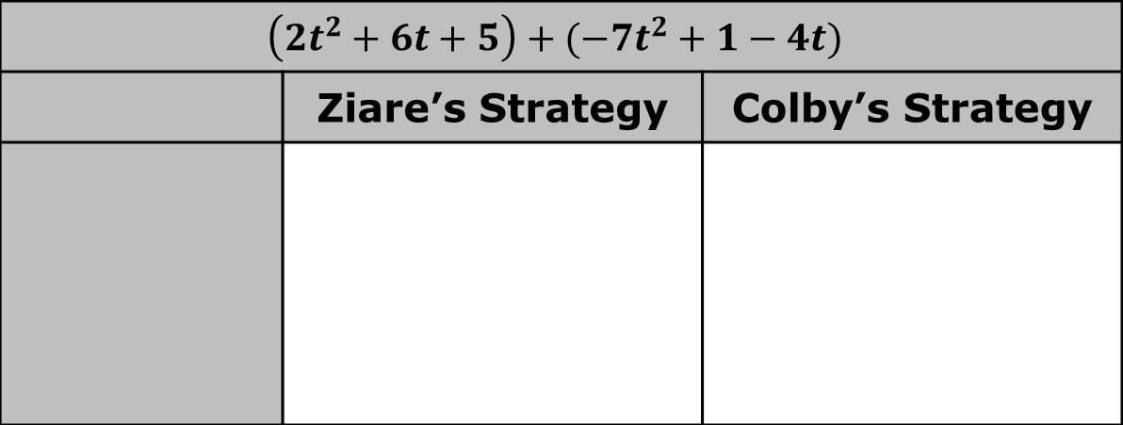
When adding and subtracting polynomials, only like terms can be combined.
Ziare and Colby used different strategies to add the polynomials $(2t^{2}+6t+5)$ and $(−7t^{2}+1−4t)$.
Work with your partner to describe what each student did and identify one helpful aspect used in their strategy.
$$\left(2t^{2}+6t+5\right)+(−7t^{2}+1−4t)$$
 | Ziare’s Strategy | Colby’s Strategy
volume 1, pg. 81

Slide 11
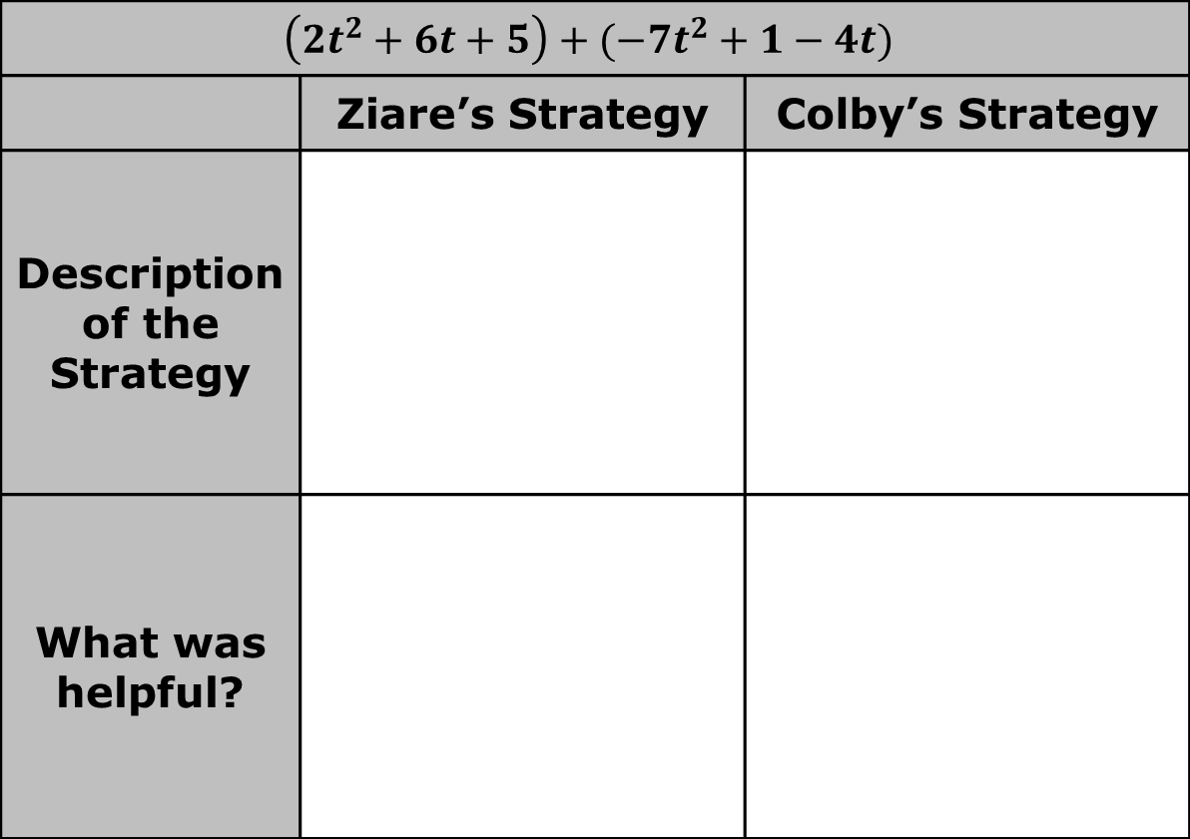
$$\left(2t^{2}+6t+5\right)+(−7t^{2}+1−4t)$$
 | Ziare’s Strategy | Colby’s Strategy
Description of the Strategy
What was helpful?
volume 1, pg. 81

Slide 12

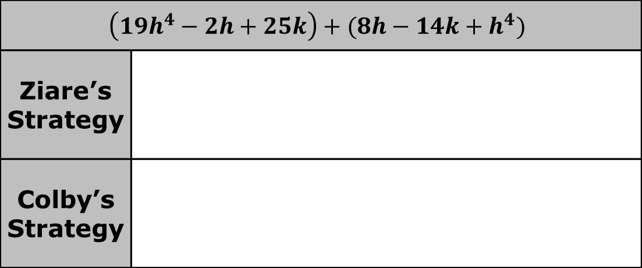
Find the sum of $(19h^{4}−2h+25k)+(8h−14k+h^{4})$ using both Ziare’s and Colby’s strategies.
Find the sum using your preferred method. Write the sum in standard form.
$$(−3p^{3}k−2k^{2}+1.4p)+(2.7p^{3}k−4.6p+5.8k^{2})$$
$$\left(19h^{4}−2h+25k\right)+(8h−14k+h^{4})$$
Ziare’s Strategy
Colby’s Strategy
volume 1, pg. 81

Slide 13

Collaboration
volume 1, pg. 82

Slide 14

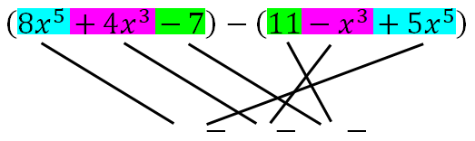
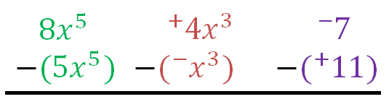
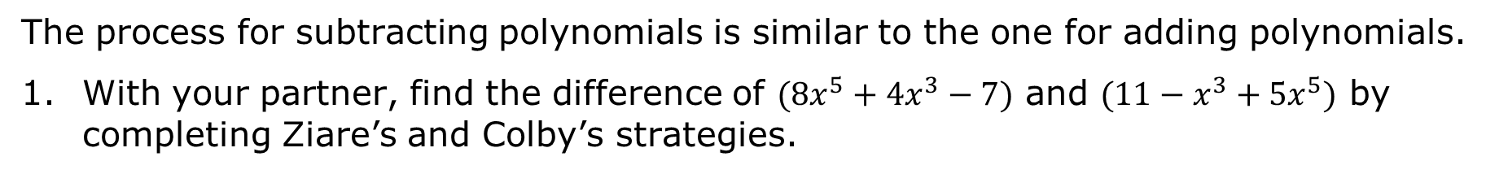
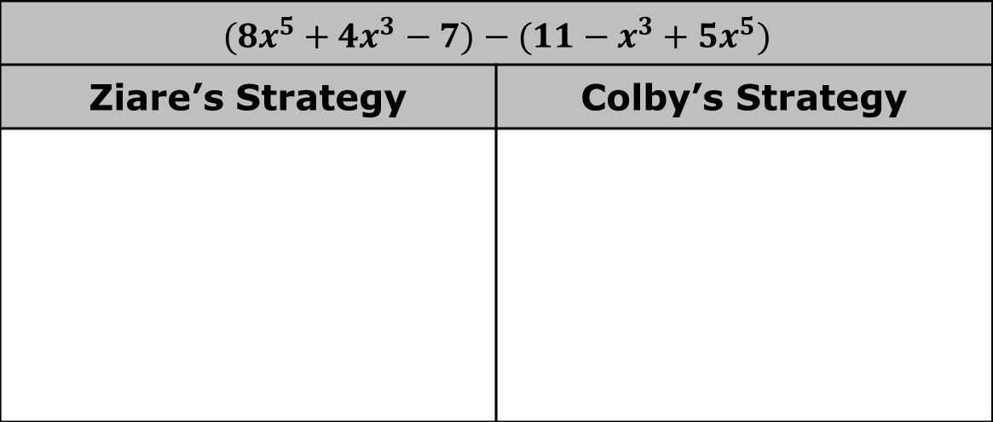
2.5.3 Collaboration: Subtracting Polynomials
The process for subtracting polynomials is similar to the one for adding polynomials.
With your partner, find the difference of $(8x^{5}+4x^{3}−7)$ and $(11−x^{3}+5x^{5})$ by completing Ziare’s and Colby’s strategies.
$$(8x^{5}+4x^{3}−7)−(11−x^{3}+5x^{5})$$
Ziare’s Strategy | Colby’s Strategy
volume 1, pg. 82

Slide 15
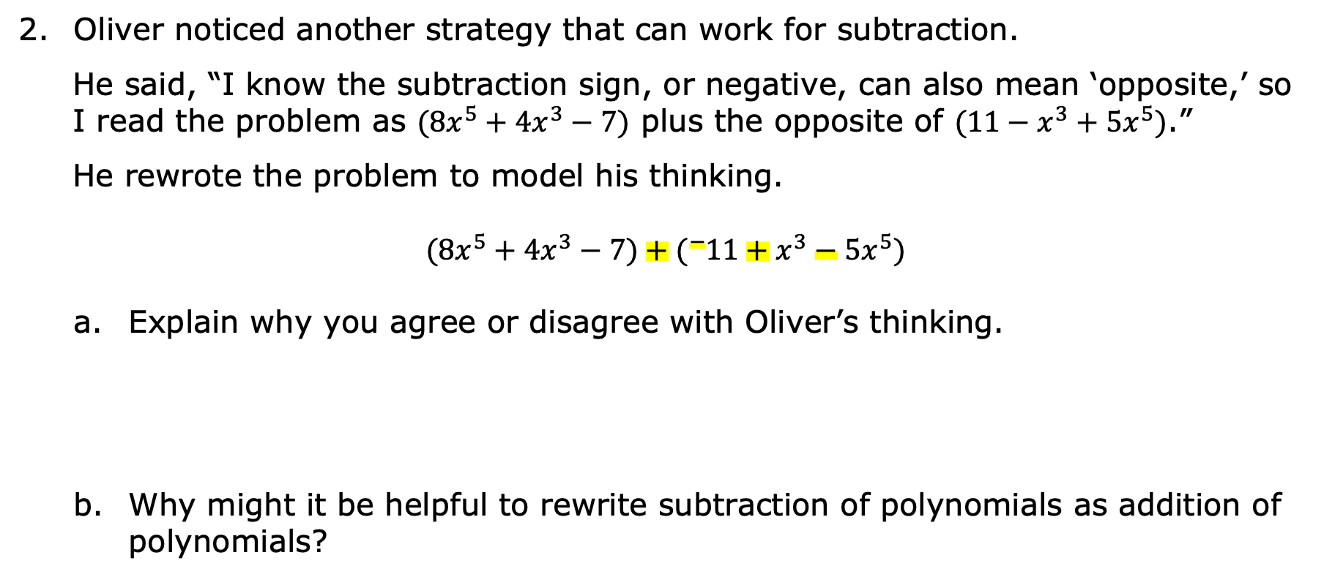
Oliver noticed another strategy that can work for subtraction.
He said, “I know the subtraction sign, or negative, can also mean ‘opposite,’ so I read the problem as $(8x^{5}+4x^{3}−7)$ plus the opposite of $(11−x^{3}+5x^{5})$.”
He rewrote the problem to model his thinking.
$$(8x^{5}+4x^{3}−7)+({}_{ }^{−}{11}+x^{3}−5x^{5})$$
Explain why you agree or disagree with Oliver’s thinking.
Why might it be helpful to rewrite subtraction of polynomials as addition of polynomials?
volume 1, pg. 82

Slide 16
Find the difference of $(5m^{2}−4)$ and $(8m+4+3m^{2})$. Write the resulting polynomial in standard form.
volume 1, pg. 83

Slide 17

Guided Practice
volume 1, pg. 83

Slide 18

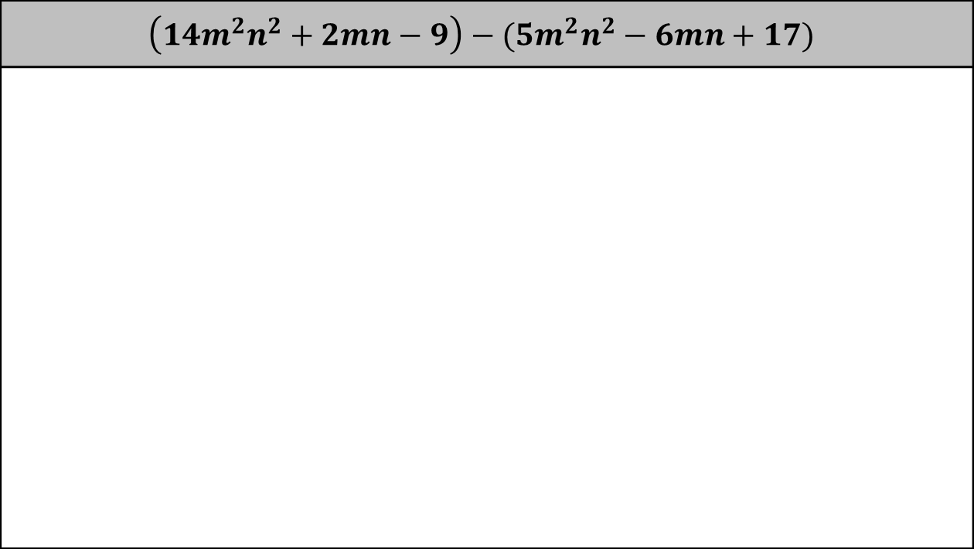
2.5.4 Guided Practice: Adding and Subtracting Polynomials
Find each sum or difference. Write the result in standard form.
$$\left(1{4m}^{2}n^{2}+2mn−9\right)−(5m^{2}n^{2}−6mn+17)$$
volume 1, pg. 83

Slide 19
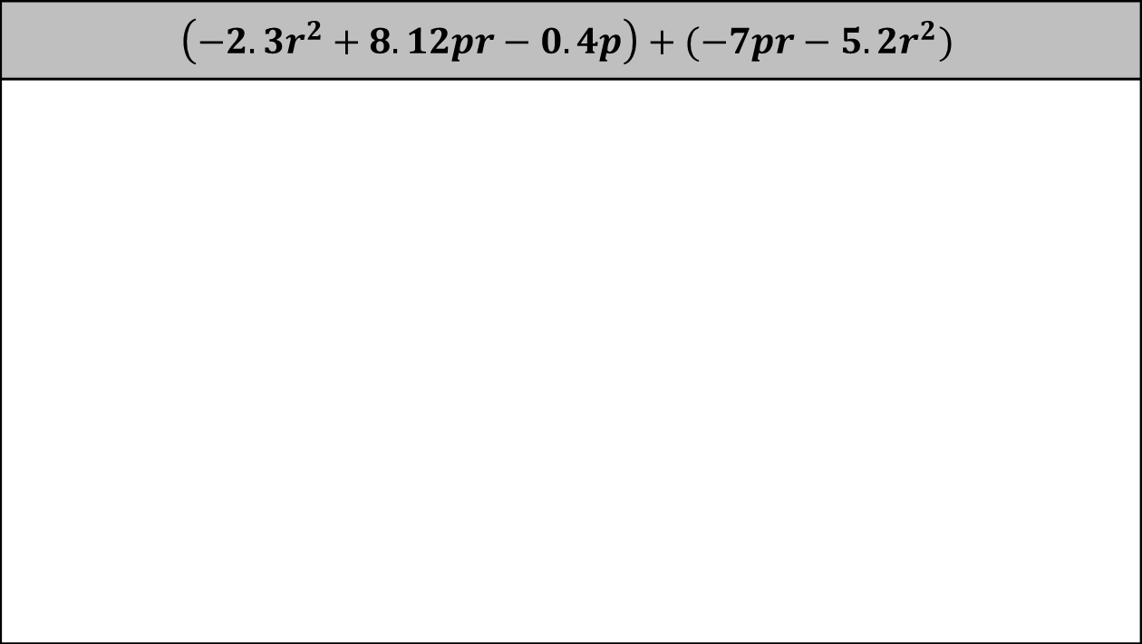
$$\left(−2.3r^{2}+8.12pr−0.4p\right)+(−7pr−5.2r^{2})$$
volume 1, pg. 83

Slide 20

Your Turn
volume 1, pg. 84

Slide 21

2.5.5 Your Turn!
Find each sum or difference. Write the result in standard form.
1. $(ab^{2}+13b−4a)−(7b+a+\frac{1}{3}ab^{2})$
2. $(8m^{5}+4m^{3}−9)−(11+5m^{5}−m^{3})$
3. $({}_{ }^{−}9d+5d^{2}+3)+(5d−d^{2}+13)$
volume 1, pg. 84

Slide 22
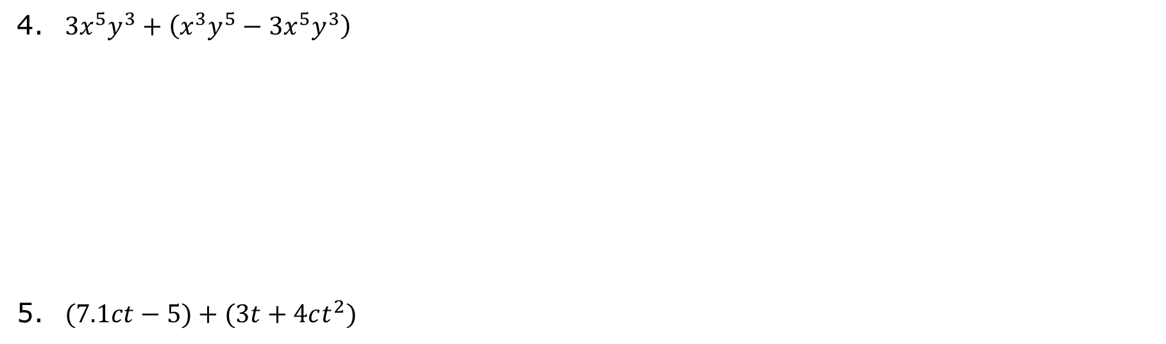
4. $3x^{5}y^{3}+\left(x^{3}y^{5}−3x^{5}y^{3}\right)$
5. $(7.1ct−5)+(3t+4ct^{2})$
volume 1, pg. 84

Slide 23

Wrap-Up
volume 1, pg. 85

Slide 24
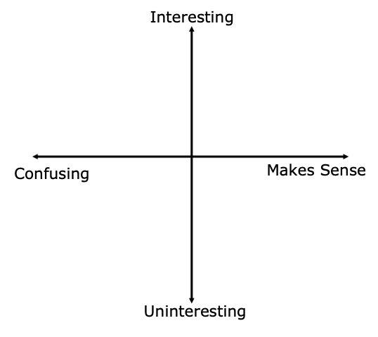
2.5.6 Wrap-Up: Reflection
Plot a point in one of the quadrants to indicate how you feel about today’s learning target, “I can add and subtract polynomials.”
volume 1, pg. 85

Slide 25
Describe why you plotted your point in that location.
volume 1, pg. 85

